Slide 1
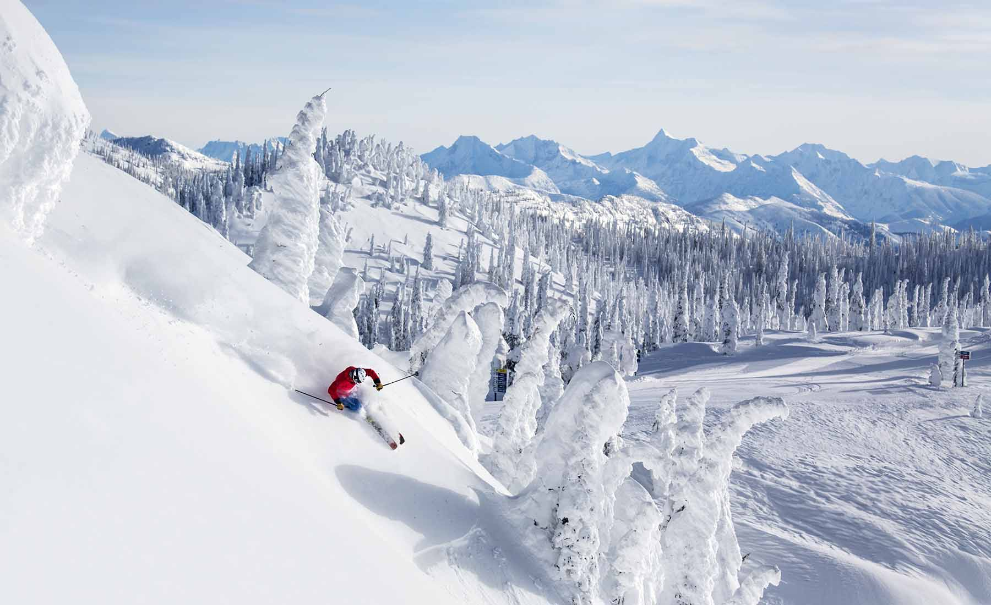
Big Mountain Resort

Slide 2

Problem identification
Resort expanded its facilities
installing a new chair lift
Costs of approximately $1.5 million
Pricing decisions and maximize revenue
leveraging data analysis and ML techniques

Slide 3
Recommendation
Focus on enhancing vertical drop
Significantly increase revenue.
Perform a cost-benefit analysis for snowmaking
Justify higher ticket prices
Without reducing visitor numbers.

Slide 4
Key Findings
Increase vertical drop by 150 feet and add a new chair lift.
Permanent closure of up to ten of the least used runs.
Extend the longest run by 0.2 miles.

Slide 5
Modeling results
Models
Linear regression
Random forest
Gradient boosting machines
Cross-validation techniques
Ensure the robustness of the models

Slide 6
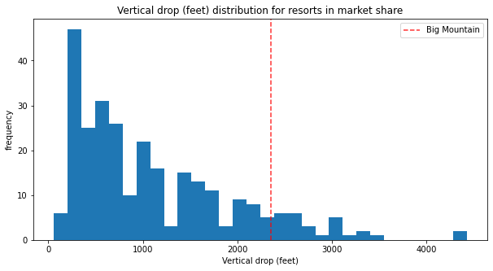
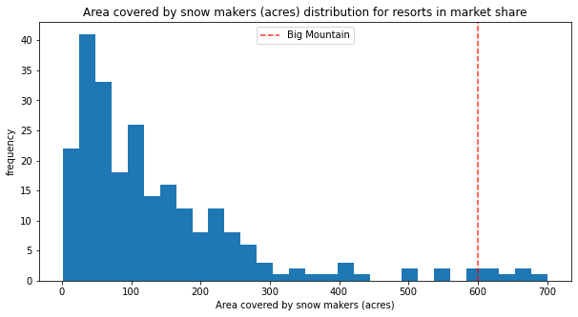
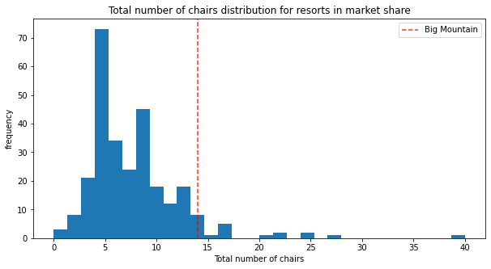
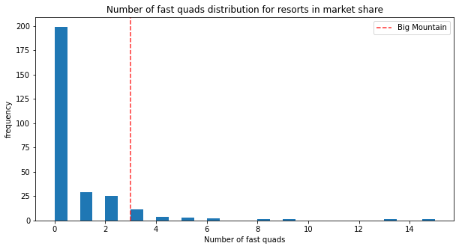
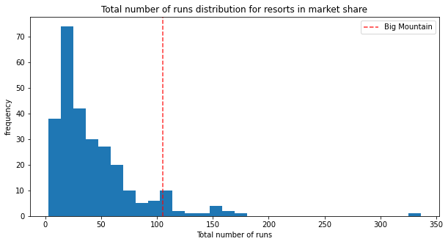
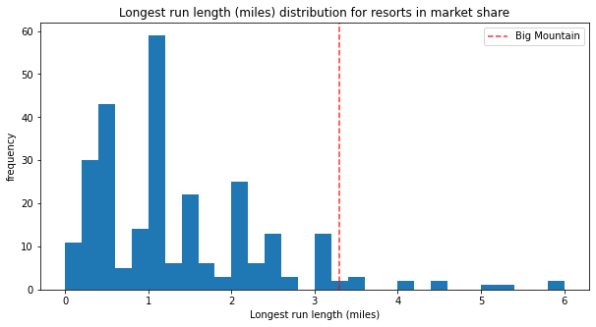
Analysis

Slide 7
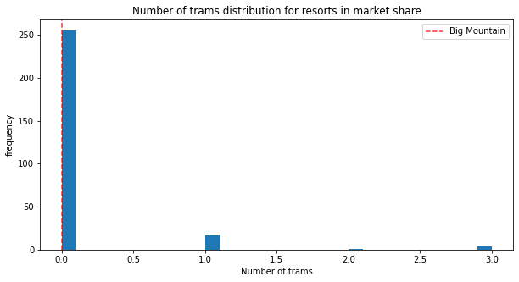
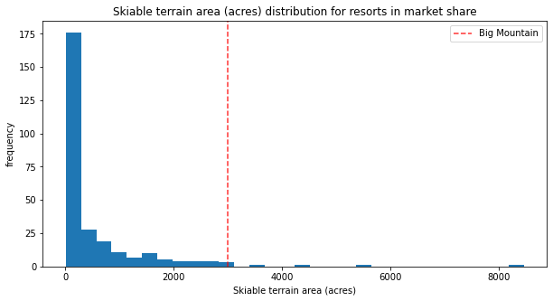
Analysis

Slide 8
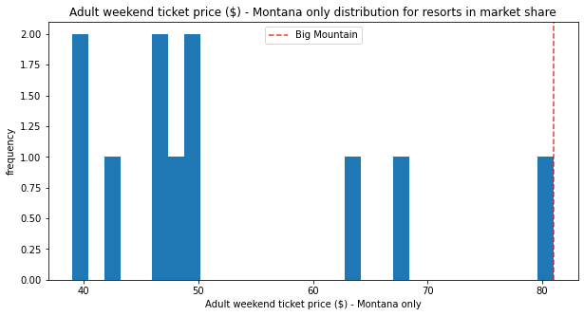
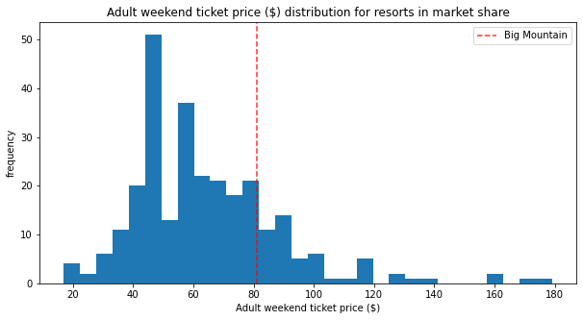
Montana Ticket Price vs. Others

Slide 9
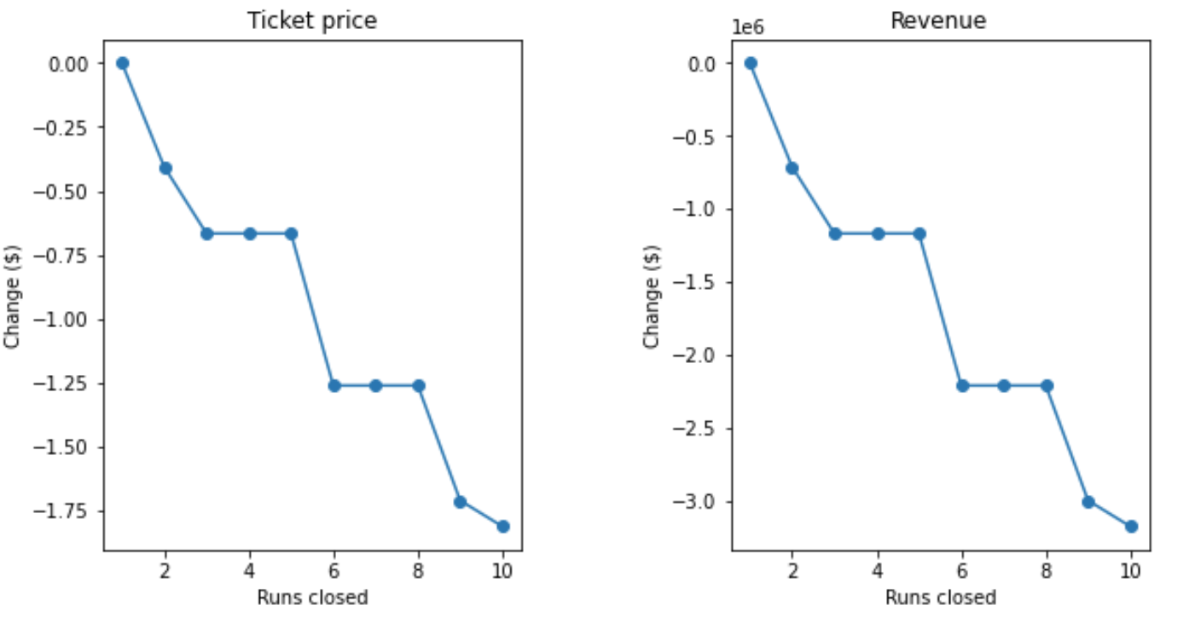
Conclusion
Closing up to 5 runs
Minimally impact ticket pricing
Result in a revenue drop of about $500,000
Additional closures
Disproportionate decrease in ticket prices
Tripling of revenue loss

